Slide 1
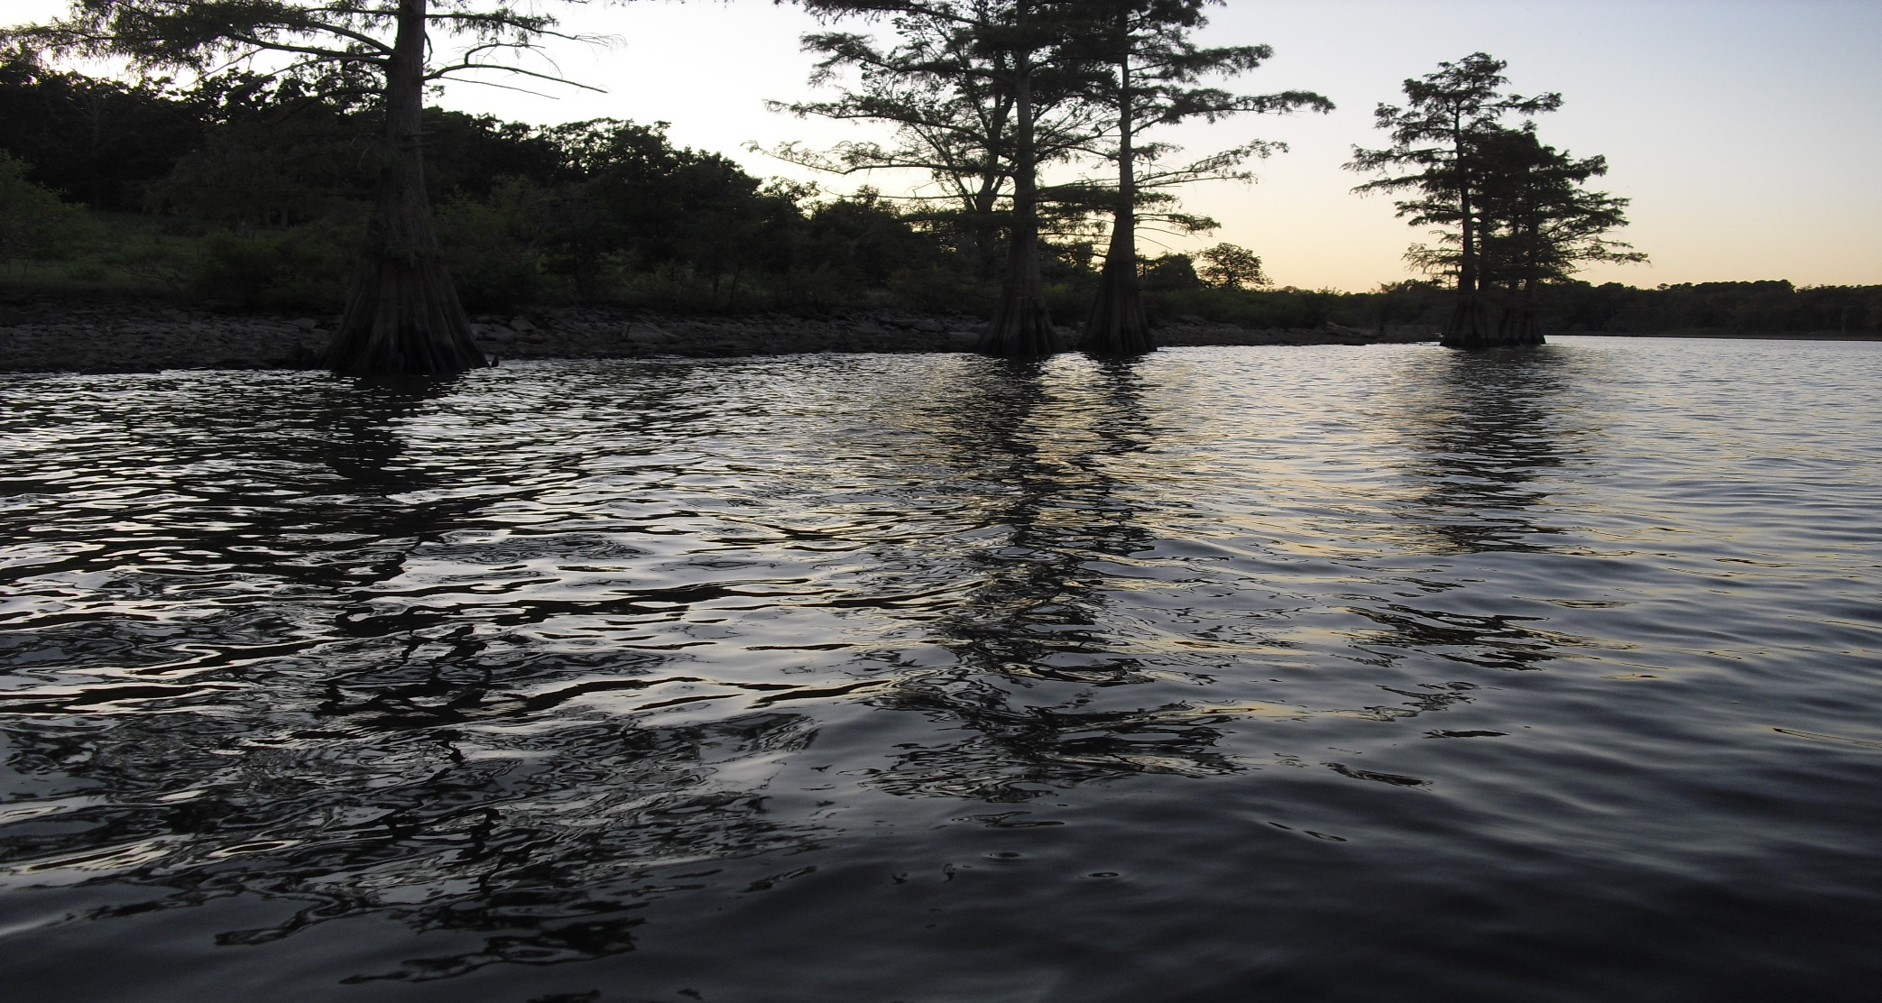

OKR04 Required 303(d) Priority Area Inspections
Prepared by INCOG
GCSA Training Module
Part 1 of 3
September 2021
Notes:
INCOG originally scheduled an August 18th GCSA Employee Training Workshop at Nienhuis Park as a return to physical meetings.
Due to increased COVID infections statewide, the Nienhuis workshop was re-scheduled as a Zoom meeting for the same date.
Unfortunately, a COVID quarantine problem at INCOG prevented hosting of the August 18th Zoom meeting.
The single 2 hour presentation has been split into three narrated PowerPoint Training Modules on the same topic of 303(d) priority area inspections.
This is Module 1 which provides an overview of the 303(d) impairment program and Oklahoma’s water quality standards (WQS).
Each of the three narrated modules can be used for training local staff and as refreshers on the topics.

Slide 2
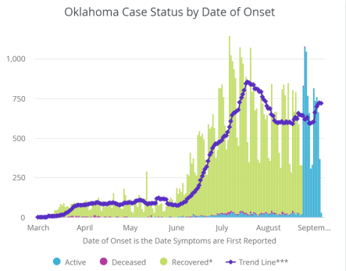
How Much More Virtual Training?
COVID is surging, and back to school and holidays may keep COVID high this fall.
Our last GCSA physical meeting was in December 2019 (21 months ago)
The August 18th workshop was to be our return to physical meetings.
The Oct. 13th and Dec. 15th workshops at Nienhuis Park have been switched to Zoom meetings.
Graph copied from OSDH Data
Notes:
As of mid-August, the COVID infections and hospitalizations in Oklahoma and Tulsa County rose to record levels.
The latest trend as of mid-September suggests the beginning of a decline in infections, but the overall numbers are still too high to host physical meetings.
INCOG last hosted a physical workshop in December 2019, 21 months ago.
In the interim, INCOG has hosted numerous Zoom meetings on a variety of topics.
Future outreach to GCSA will continue as Zoom meetings until 2022 when workshops can (hopefully) once again be safely held.
Final decisions of meeting venue type must be made near the time of planned event date.

Slide 3

Training Module Topics
Module 1:
Status of GCSA training in CY 2021
Regulatory basis of OKR04 stormwater permit
Overview of 303(d) impairment and water quality standards
Module 2:
OKR04 303(d) requirements
Determining discharges to receiving waters
Integrated Report categories and appendices
Watersheds of 303(d) waterbodies and 303(d) priority areas
Pollutants of Concern (POCs) for each GCSA member
Module 3:
Lake impairment issues
Biological impairment issues
Basics of field inspection programs
Field inspection program suggestions and methods
3
Notes:
For this GCSA training outreach, the topic of 303(d) priority area inspections has been broken into three narrated PowerPoint modules.
Today’s Module 1 will provide an overview of 303(d) impairment and Oklahoma’s water quality standards (WQS).
Module 2 will address greater details of the 303(d) requirements in OKR04 and specific technical issues important to 303(d) impairment.
Module 3 will focus on the technical aspects of lake and biological impairment and field inspection methods.

Slide 4
CY-21 (Q1-2) Schedule of GCSA Meetings
2021 DATE | TYPE | ZOOM MEETING AND GCSA WORKSHOP TOPICS
January 13 | Zoom Meeting | Quality Assurance Overview: Purpose of QA, what QA covers, recordkeeping, SOPs, QAPPs, data collection and analysis. (completed)
February 24 | Zoom Meeting | Watersheds and WBIDs: Defining watersheds, WBID system, acquiring GIS data, HUC versus WBID, data limitations. (completed)
March 10 | Zoom Meeting | MS4 system mapping: OKR04 requirements, GIS versus paper, priority areas, defining outfalls, other map features. (completed)
April 28 | Zoom Meeting | Final OKR04 Permit and Applications: OKR04 overview, MS4 Categories and MCM changes, new TMDL strategies, sampling and inspections, LID compliance, NOIs, SWMP updates and Annual Reports. (DEQ hours, completed)
May 12 | Zoom Meeting | SWMP Template BMP Timelines and Assessments: History, new Template strategy, OKR04 SWMP requirements, BMP implementation changes, BMP Measurable Goals and timelines, assessing BMPs and program and signatory requirements. (DEQ hours, completed)
Notes:
These next two slides present the latest version (as of mid-September) of GCSA Meetings through Calendar Year (CY) 2021.
All Zoom meetings scheduled for the first half of 2021 were held, including the three offering DEQ operator license renewal training.
The last quarter’s previously scheduled meetings on TMDL and sampling issues have been replaced by SWMP related topics.

Slide 5
CY-21 (Q3-4) Schedule of GCSA Meetings
2021 DATE | TYPE | ZOOM MEETING AND GCSA WORKSHOP TOPICS
June 9 | Zoom Meeting | BMP Implementation and DEQ Enforcement: BMP implementation in OKR04, changing BMPs and signatory requirements, BMP local resources, BMP recordkeeping, DEQ’s findings of program noncompliance, DEQ enforcement. (DEQ hours, completed)
August 18 | Zoom Meeting (cancelled) | 303(d) Priority Area Inspections: identifying Pollutants of Concern (POCs), setting priority areas, inspecting for significant POC discharge sources, field methods. (replaced by narrated and annotated PowerPoints)
October 13 | Zoom Meeting | Updating SWMPs and Program and BMP Assessment Concepts: SWMP purpose, update timelines, DEQ reviews of SWMPs, OKR04 SWMP requirements, key provisions, SWMP format.
November 10 | Zoom Meeting | Using the INCOG SWMP Template To Meet New OKR04 Requirements: SWMP preparation options, template contents and format, addressing 2021 OKR04 requirements, how to enter local data, content and format options.
December 15 | Zoom Meeting | Measurable Goals, Implementation Schedules and Assessing Programs and BMPs: Setting practical measurable goals and implementation schedules, method options for assessing SWMP programs and BMPs.
Notes:
The August 18th Zoom meeting had to be cancelled due to an INCOG quarantine issue.
The meeting topics are being converted into three narrated and annotated PowerPoints for local training use.
These 3 narrated and annotated training module PowerPoints will be posted on the GCSA Member Resources web page.
DEQ has begun to request SWMP reviews of certain MS4s, with more requests planned for 2022.
This changes INCOG’s priorities and GCSA support schedules for the next 4 months to complete a SWMP template and guidance.
INCOG recently prepared a GCSA News Bulletin and Announcement on these changes along with a new Fiscal Year (FY) GCSA training and meeting schedule.

Slide 6
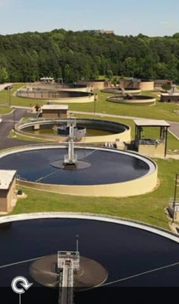
Stormwater Permits are NPDES Permits
NPDES (National Pollutant Discharge Elimination System)
40 CFR Part 122 - 124 of EPA Federal Regulations.
Oklahoma has Primacy = DEQ is the OPDES “Permitting Authority”
OPDES permits address “Point Source” discharges from:
    Wastewater treatment plants
    Stormwater MS4 runoff (Phase I and II regs)
    Stormwater Construction activities ≥1 acre (1990 Phase I regs)
    Stormwater Industrial activities (1990 Phase I regs)
Notes:
We have many new GCSA member program managers who have limited background in stormwater permits, so a brief refresher is needed on the federal rule basis of OKR04.
DEQ covers three types of stormwater “general permits”: OKR04 (small municipal), OKR05 (industrial) and OKR10 (construction).
In addition, DEQ allows individual permits for stormwater, but nearly all dischargers opt for coverage under general permits.
All stormwater permits are required by the federal Clean Water Act (CWA) which is implemented under EPA regulations.
In the late 1990s, EPA granted DEQ responsibility (“primacy”) for managing Oklahoma’s stormwater permitting programs.
EPA retained authority over stormwater permitting of Indian Tribes, and different Oklahoma state agencies cover stormwater discharges from certain agricultural and oil and gas activities.
EPA’s stormwater rules were adopted “by reference” in state statutes. These include 40 CFR Parts 122 – 124.
Part 122.26 contains the bulk of EPA’s stormwater regulations, but there are stormwater requirements in many other CFR parts.

Slide 7
40 CFR 122.26+ EPA Stormwater Rules
PART 122—EPA ADMINISTERED PERMIT PROGRAMS: THE NATIONAL POLLUTANT DISCHARGE ELIMINATION SYSTEM [NPDES]
Subpart A—Definitions and General Program Requirements
122.1 thru 122.7
Subpart B—Permit Application and Special NPDES Program Requirements
122.21 thru 122.38
Includes 122.26, et. seq. (storm water discharges)
Subpart C—Permit Conditions
122.41 thru 122.50
Subpart D—Transfer, Modification, Revocation and Reissuance, and Termination of Permits
122.61 thru 122.64
Appendices A thru J
Notes:
40 CFR Part 122 is divided into 4 sub-parts (A through D).
The links in this slide take you to online copies of each subpart.
Subpart B includes Part 122.26, the bulk of EPA’s stormwater provisions.
It is not necessary to refer to EPA rules for stormwater permit compliance, but sometimes it’s important to see where general permit passages come from.

Slide 8
OKR04 Part VII.A Duty To Comply Penalties
PENALTY TYPE | PROVISION | AMOUNT | PERIOD | PROVISION | MAX. | PRISON
Civil | May be assessed up to | $10,000 | Per day | Per violation | -- | --
Admin | May be assessed up to | $10,000 | Per Day | Per violation | $125,000 | --
Criminal Action | May range from a minimum of | $2,500 | Per day | To the maximum of | $2 million | 30 years
Permit Fraud | Subject to a maximum of | $20,000 | -- | And a maximum of | -- | 4 years
Notes:
OKR04 Part VII.A contains the penalty provisions for OKR04 permit noncompliance.
There are 4 types of noncompliance, each having its own set of penalties.
The OKR04 penalty provisions closely mirror those in EPA rules and state statutes for permit noncompliance for other types of discharges, such as from wastewater treatment.
DEQ has the authority to enforce OKR04 using these penalty provisions and they are doing so as needed.

Slide 9
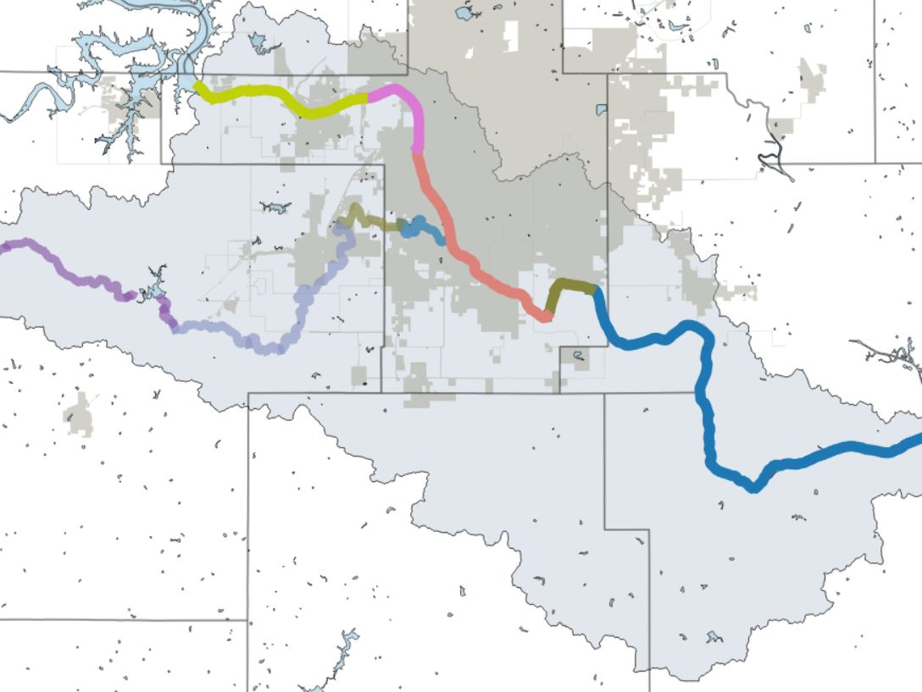
Defining Sensitive Waters Terms
Covered in OKR04 Part IV “Special Conditions” and elsewhere in permit.
303(d) – Biennial report to Congress on impaired waters; found as Appendix C in ODEQ’s Integrated Report.
TMDL - Total Maximum Daily Load; a special study that sets load limits of 303(d) pollutants.
ARC - Aquatic Resources of Concern; waterbodies having rare or endangered species and their critical habitat that require extra protection (ARC areas are set by ODWC and USFWS).
ORW – Outstanding Resource Waters; given special protection due to their exceptional water quality.
Notes:
OKR04 Part IV is titled “Special Conditions and Compliance With Water Quality Standards”.
This is the main area of the permit addressing 303(d) impairment and TMDLs.
Part IV also has a single but very important paragraph for addressing Outstanding Resource Waters (ORW).
Aquatic Resources of Concern (ARC) are another type of sensitive waters requiring special attention, but ARC requirements are spread in different places in the permit.
To find all OKR04 provisions addressing any of these “Sensitive Waters”, it’s best to do a word search of the permit document.
Addressing OKR04’s requirements for TMDLs is a work in progress by DEQ with important implementation aspects still undecided.
Fortunately OKR04 allows several years for TMDL implementation strategies to be finalized.
The OKR04 requirements to address 303(d) impairment did not significantly change in the new 2021 permit, but many MS4s still struggle with 303(d) compliance.

Slide 10
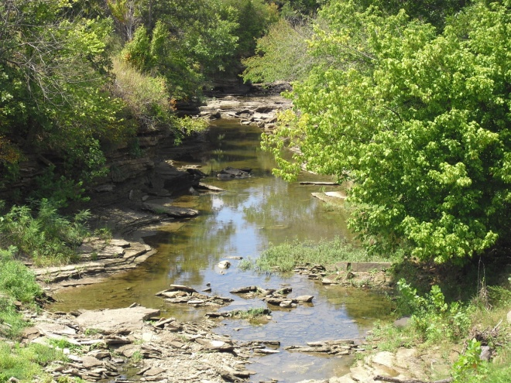
Oklahoma WQS Beneficial Uses
Public and Private Water Supply
Emergency Water Supply
Fish and Wildlife Propagation
    Habitat Limited Aquatic Community
    Warm Water Aquatic Community
    Cool Water Aquatic Community
    Trout Fishery (put and take)
Recreation (Primary & Secondary Body Contact)
Agriculture
Aesthetics
Navigation
Fish Consumption
BU combinations are designated for every waterbody in the State.
Notes:
Oklahoma’s water quality standards (WQS) have three components: 1) establishing Beneficial Uses for all Oklahoma waterbodies, 2) setting narrative and numerical BU protection criteria, and 3) anti-degradation requirements for special waters.
Beneficial Uses (BUs) are a checklist of how each waterbody is most likely to be used.
Unless site-specific BUs are assigned by a Use Attainability Analysis (UAA) study, all waterbodies are assigned a default set of BUs.
BUs address recreation, water supply, fish consumption, agriculture, navigation, aesthetics and fish and wildlife propagation, all aspects of how a waterbody might be used.
Every waterbody in the state has its own set of BUs which are found in Chapter 45 Appendix A of the Oklahoma WQS.

Slide 11
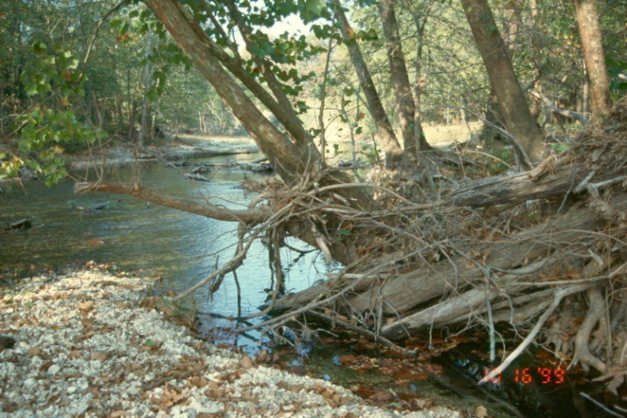
303(d) Impairment
Nonattainment of one or more Beneficial Uses can be caused by:
Dissolved oxygen, nutrients
Toxics (metals, organics, pesticides)
Sediment, suspended solids, turbidity
Pathogens (bacteria)
Biological (fish, macroinvertebrates)
pH
Oil & grease
Chloride, sulfate, TDS
Notes:
DEQ is required by EPA to submit a biennial Integrated Report to EPA on the status of water quality in Oklahoma’s surface waters.
This slide shows the various types of data that can lead to 303(d) listings. There are many specific parameters under these general categories.
A given waterbody can be 303(d) impaired for one to many different parameters, called 303(d) Pollutants of Concern (POCs).

Slide 12
The Oklahoma 303(d) List
2020 is the latest 303(d) List; approved July 2021.
Biennial process (every 2 years, 2020 is the process start date).
Science-based. Formal sampling required.
Uses the OWRB’s Chapter 45 WQS and Chapter 46 303(d) assessment procedures.
DEQ coordinates the assessments and prepares the Integrated Report.
303(d) impairments apply to the WQS Beneficial Uses.
Most waterbodies remaining 303(d) impaired will have TMDLs.
A few will have “Watershed Based Plans” in lieu of TMDLs.
Notes:
Appendix C of the Integrated Report (IR) is a list of all waterbodies that have been determined to not be meeting one or more of each waterbody’s BUs.
To determine BU status, agencies and organizations collect qualifying scientific data and follow specific assessment procedures to determine if any BU is impaired.
If BU impairments are found, then the waterbody is placed on the 303(d) impairment list in Appendix C of the biennial IR.
Often, waterbodies can have changes in their 303(d) POCs, and some can even go off and back on the list over a period of time.
Impairments that persist on the 303(d) list will eventually have a TMDL study to determine all potential sources of the TMDL’s POC.
Although somewhat rare, some waterbodies will have a different type of assessment study, called a Watershed Based Plan, in lieu of a TMDL.
Regardless, OKR04 permittees must meet all requirements of either the watershed plan or the TMDL.

Slide 13
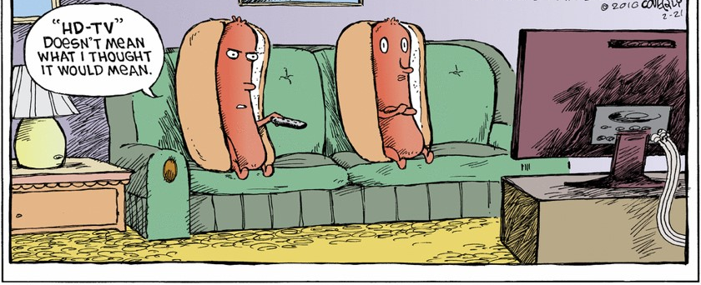
What 303(d) covers at present:
  Streams, rivers and creeks with WBIDs
  Lakes (publicly owned; e.g., Corps, municipal, etc.)
What 303(d) does not cover yet:
  Wetlands
  Small private lakes and ponds
  Groundwater
  Waterbodies not defined as “Waters of the State”
Types of Waterbodies in 303(d)
Notes:
Not all types of waterbodies and waters in Oklahoma have 303(d) assessments.
Presently 303(d) is limited to “lotic” (streams, rivers and creeks) with Waterbody Identification (WBID) codes assigned, and to “lentic” (lakes) that are for the most part publicly owned.
Waterbodies not presently addressed by 303(d) assessments are wetlands, small private lakes and ponds, groundwater and waterbodies not defined as “Waters of the State”.

Slide 14
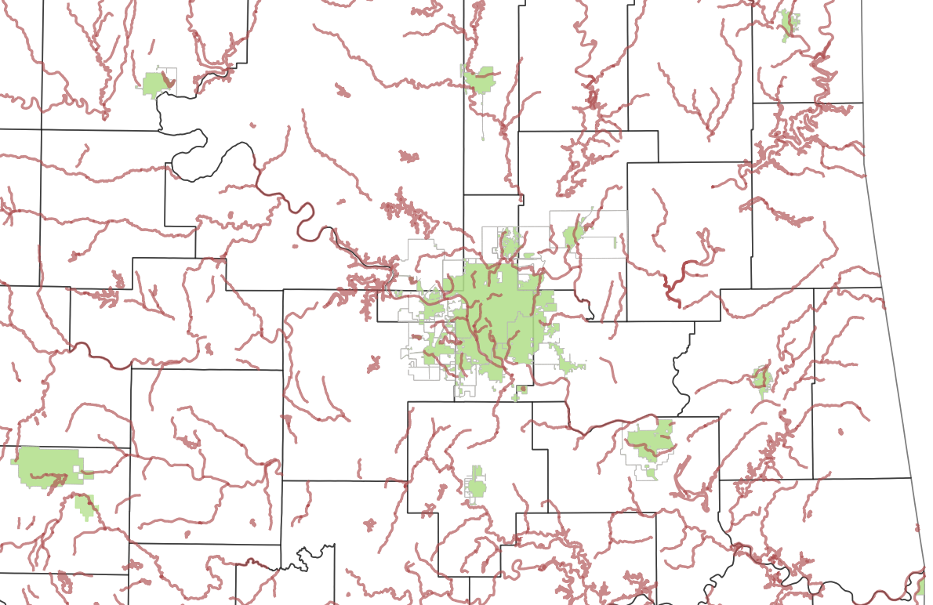
2020 303(d) Waters By GCSA Member MS4s
All 25 GCSA Members have at least one 303(d) impaired waterbody within or adjacent to their MS4.
OKR04’s Part IV.A “Special Conditions” has most of OKR04’s 303(d) requirements.
Notes:
All 25 GCSA members MS4s have at least one 303(d) impaired waterbody, either within the MS4 area or adjacent to as a stormwater discharge receiving water.
The bulk of OKR04’s permit requirements for addressing 303(d) are found in Part IV.A.

Slide 15
How 303(d) Segments & Listings Change
Arkansas River segments in Tulsa area.
SEGMENT | 1998 303(d) |  | 2002 303(d) | 2004 303(d) | 2006 303(d) | 2008 303(d) | 2010 303(d) | 2012 303(d) | 2014 303(d) | 2016 303(d) | 2018 303(d)
OK120420010130_00 | Metals Pathogens Pesticides Organics |  | Cat. 2 | Cat. 2 | Cat. 2 | O&G 5a TDS 5a | Turb 5a Thall 5a O&G 5a | Turb 5a O&G 5a Ent 4a | Turb 5a | Turb 5a | Turb 5a Ent 4a
OK120420010010_10 | Metals Pathogens Pesticides Organics |  | Not listed in 2002 IR | Cat. 3 | Cad 5a FC 5a | Cad 5a FC 5a | Cad 5a FC 5a | Cad 5a | Cd 5a | Cd 5a | Cd 5a
OK120420010010_00 |  |  | Lead 5 | FC 5 Ent 5 Ecol 5 | FC 5a Ent 5a Ecol 5a | FC 5a Ent 5a TDS 5a Lead 5a O&G 5a | Turb 5a Thall 5a O&G 5a | Turb 5a O&G 5a Ent 4a | Turb 5a Ent 4a | Turb 5a Ent 4a | Turb 5a Ent 4a
OK120410010080_10 | Pathogens Pesticides Organics |  | Cat. 3 | Cat. 3 | FC 5a | FC 5a | FC 5a | Cat. 2 | Cat. 2 | Cat. 2 | Cat. 2
OK120410010080_00 |  |  | Path 5 TDS 5 | Ent 5 TDS 5 Turb 5 | TDS 5a | Ent 5a TDS 5a O&G 5a | Thall 5a O&G 5a | Ent 4a | Ent 4a | Ent 4a | Ent 4a
Notes:
This table illustrates how 303(d) listings can change over the years, often frequently.
The table reflects 2 types of changes: 1) stream segmentation, and 2) POC parameter changes.
Long streams and rivers are often segmented into two or more smaller segments, and even some of the sub-segments can be further segmented.
Sub-segmentation is noted in the WBID code system by the underscore number as the “_10” at the end of the WBID code.
For example, a WBID segment coded as OK121300010010_00 might be split into 2 segments, with the new sub-segment coded as OK121300010010_10.
Note also in the table that the earliest 303(d) listings in the late 1990s were general (“metals” or “pesticides”). This is because those listings were often assumptions not supported by specific data sets.
If an OKR04 permitted MS4 has a WBID segment that changes from, say E. coli to turbidity impairment, their 303(d) program will have to change to reflect the most recent type of impairment.
However, DEQ would expect the MS4 to continue to implement the old listing’s BMPs even after the waterbody is no longer impaired.

Slide 16



This ends Part 1 of 3 GCSA Training Modules on 303(d) inspections.
Vernon Seaman
Manager, Envir. and Energy Planning
INCOG
Two West 2nd Street
Suite 800
Tulsa, OK 74103
(918) 579-9451
vseaman@incog.org
Notes:
This ends part 1 of 3 of the annotated and narrated PowerPoint of the August GCSA training modules.
Please contact Richard Smith and Vernon Seaman if you have any questions about this material or future GCSA presentations or support.

